Slide 1
Hovercraft VDP 2
Group 13
Paul Longe
Bradley
Keqi
Divine
Xiang
Alex

Slide 2
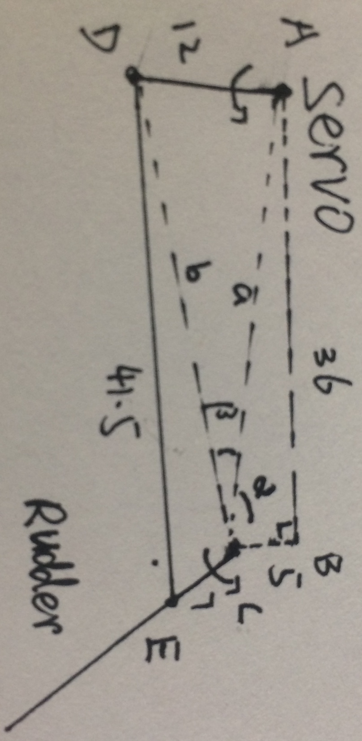
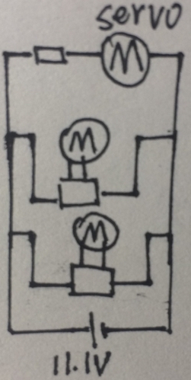
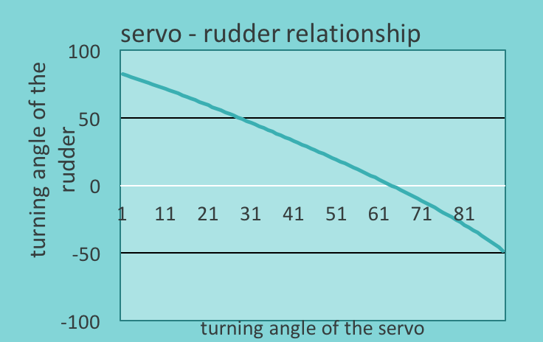
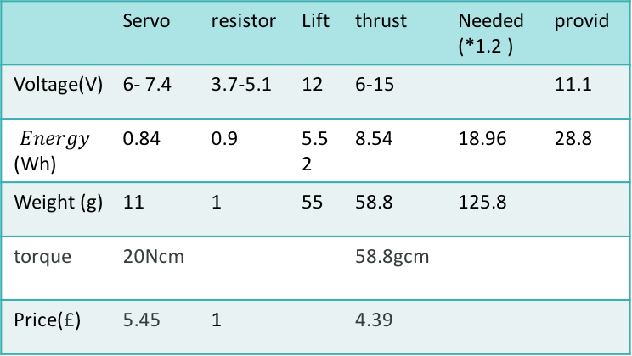
Powertrain – Final Design（as simple as possible）
Keqi Shu- Powertrain Engineer
Motor & Circuit
Study the battery & motor controller
Evaluate the torque and the turning speed under load condition.
Parallel circuit.
Power the servo by series connect a resistor.(balance the voltage)
Set up the safety ratio to 1.2.
Transmission Structure
Decided to use Linkage mechanism.
Use the most severe conditions to decided the length of links.
Use excel to have the turning angle relationship.
Change the links length and find the best solution.
Errors of servo in turning angle(strict to 100)
Turning angle difference in two sides
 | Servo | resistor | Lift | thrust | Needed (*1.2 ) | provid
Voltage(V) | 6- 7.4 | 3.7-5.1 | 12 | 6-15 |  | 11.1
$$Energy$$ (Wh) | 0.84 | 0.9 | 5.52 | 8.54 | 18.96 | 28.8
Weight (g) | 11 | 1 | 55 | 58.8 | 125.8
torque | 20Ncm |  |  | 58.8gcm
Price(£) | 5.45 | 1 |  | 4.39
Calculations & Proves
P=IV, current and voltage of servo and resistor are nearly the same .
DF =3(n -1)-2n' =1
The Law of Cosines
a²=b²+c²-2bccosA etc
The Law of Sines
sinA / a = sinB / b = sinC/c

